Slide 1
Classification of
Text Documents
using Spark

Slide 2
Our Team
Nipun Chawla (nxc141130)
Venkata Kranthi Kumar (vxd140730)
Swetha Maradana (sxm133730)
Sonakshi Pandey (sbp140130)
Pooja Purushothaman (pxp140730)
Shubham Rai (scr130130)
Adil Shaikh (aas081000)

Slide 3
Overview
Goal: Classification of Reuters news articles
We implement the following classifiers
Naive bayes
Logistic Regression
Random decision trees
Gradient Boosted Trees
1
Notes:
www.gravity.com

Slide 4
Classification and Evaluation
See percent accuracy of each of these classifiers using our method.

Slide 5
“...categorization is a necessity due to the very large amount of text documents that we have to deal with daily.”
Notes:
Published in:
· Proceeding
ADC '02 Proceedings of the 13th Australasian database conference - Volume 5 archive
Pages 215-222
Australian Computer Society, Inc. Darlinghurst, Australia, Australia ©2002
ISBN:0-909925-83-6
· Journal
Australian Computer Science Communications archive
Volume 24 Issue 2, January-February 2002
Pages 215 - 222
IEEE Computer Society Press Los Alamitos, CA, USA
table of contents doi>10.1145/563932.563930

Slide 6
Training/Test Data
Reuters 21578 collections of document used as a training set and taken from UCI machine learning repository
Comes from business stories from Reuters published in the 1980s
Collection contains 123 categories
60/40 - Using 60% as a training data and 40% as the test data
Notes:
The Reuters collection can be obtained from http://archive.ics.uci.edu/ml/machine-learning-databases/reuters21578-mld/.

Slide 7
Classifying HTML Documents
Parse XML (SAX)
Tokenize & Stemming Documents
Create dictionary of terms
Compute IDF
Vectorize using TF-IDF
Train classifiers
Notes:
PARSE XML DOCUMENTS
TOKENIZE DOCUMENTS USING STEMMER
CREATE DICTIONARY OF TERMS
COMPUTE IDF FOR TERMS
VECTORIZE USING TF-IDF SCORES
TRAIN THE CLASSIFIERS USING RELEVANT TECHNIQUE
CLASSIFY HTML DOCUMENTS

Slide 8
Process
Parse XML Documents
We extract the topic and content using a simple SAX XML parser.
Tokenize Documents
Tokenized via using English stemmer i.e. “meets” and “meeting” becomes “meet”
Dictionary
We vectorize the documents by creating a dictionary with all the words from the respective input document

Slide 9
Process
Compute IDF
TF = (Number of times term t appears in a document) / (Total number of terms in the document).
IDF =
log[(number of documents) / (number of documents containing term t) ]
TF-IDF
Vectorize each document by computing TF-IDF score for each term
Train classifiers
Use the mllib machine learning library, available in Spark for classification
Notes:
idf(term, docs) = log[(number of documents) / (number of documents containing term)] vectorize each document by computing the TF-IDF score for each term they contain:

Slide 10
Evaluating the Classifiers
Total Number of Correctly Classified Documents _____________________________________________________
Total Number of Documents
Accuracy =
Notes:
(total number of correctly classified documents) / (total number of documents)

Slide 11
Evaluation Results
 | Result
Naive Bayes(Additive Smoothing) | 66.12%
Logistic Regression(BFGS) | 68.44%
Random Decision Trees(30 Trees) | 45.49%
Gradient Boosted Trees | 61.47%
Notes:
Naive bayes
Logistic Regression
Random decision trees
SVM

Slide 12
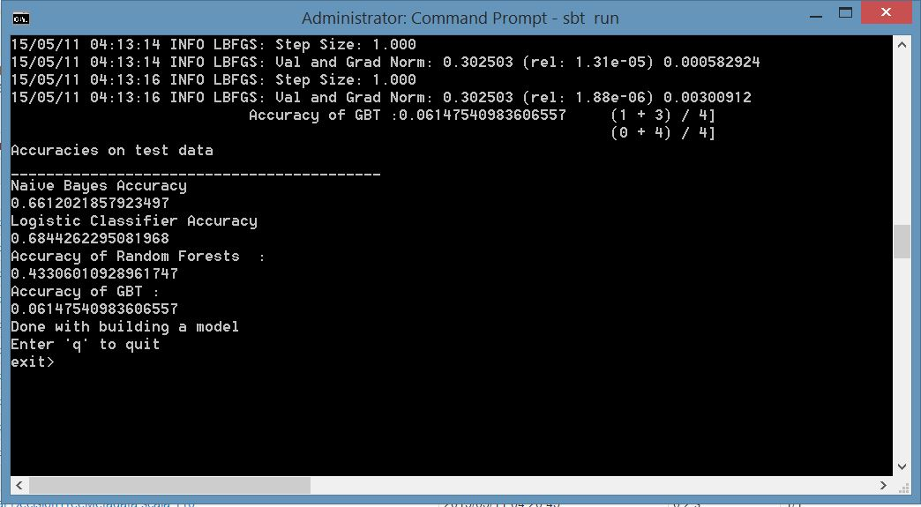
Results

Slide 13
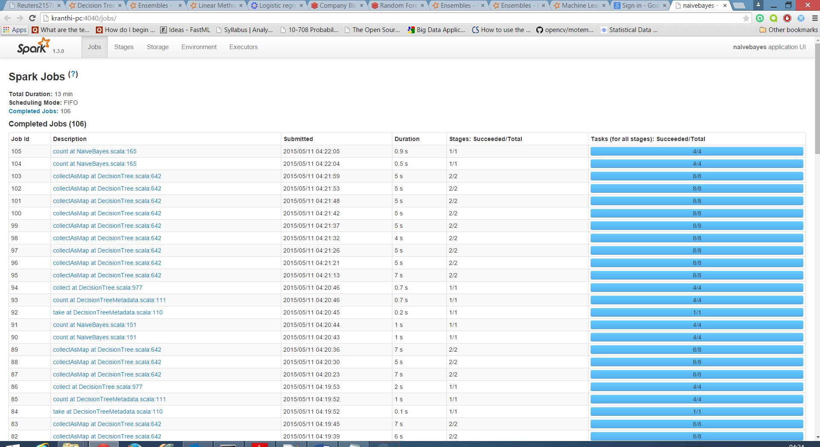
Results

Slide 14
Demo Time
Demo Slide
We will now run our demo.

Slide 15
Thanks!
Any questions?
You can reach us at:
nxc141130@utd.edu
vxd140730@utd.edu
sxm133730@utd.edu
sbp140130@utd.edu
pxp140730@utd.edu
scr130130@utd.edu
aas081000@utd.edu

Slide 16
Sources
https://spark.apache.org/docs/1.2.0/mllib-guide.html
https://github.com/GravityLabs/goose
http://dx.doi.org/10.1145/563932.563930
https://archive.ics.uci.edu/ml/datasets/Reuters-21578+Text+Categorization+Collection
Notes:
Osmar R. Za\&\#239;ane and Maria-Luiza Antonie. 2002. Classifying text documents by associating terms with text categories. Aust. Comput. Sci. Commun. 24, 2 (January 2002), 215-222. DOI=10.1145/563932.563930 http://dx.doi.org/10.1145/563932.563930

